Slide 1
Welcome!
English

Slide 2
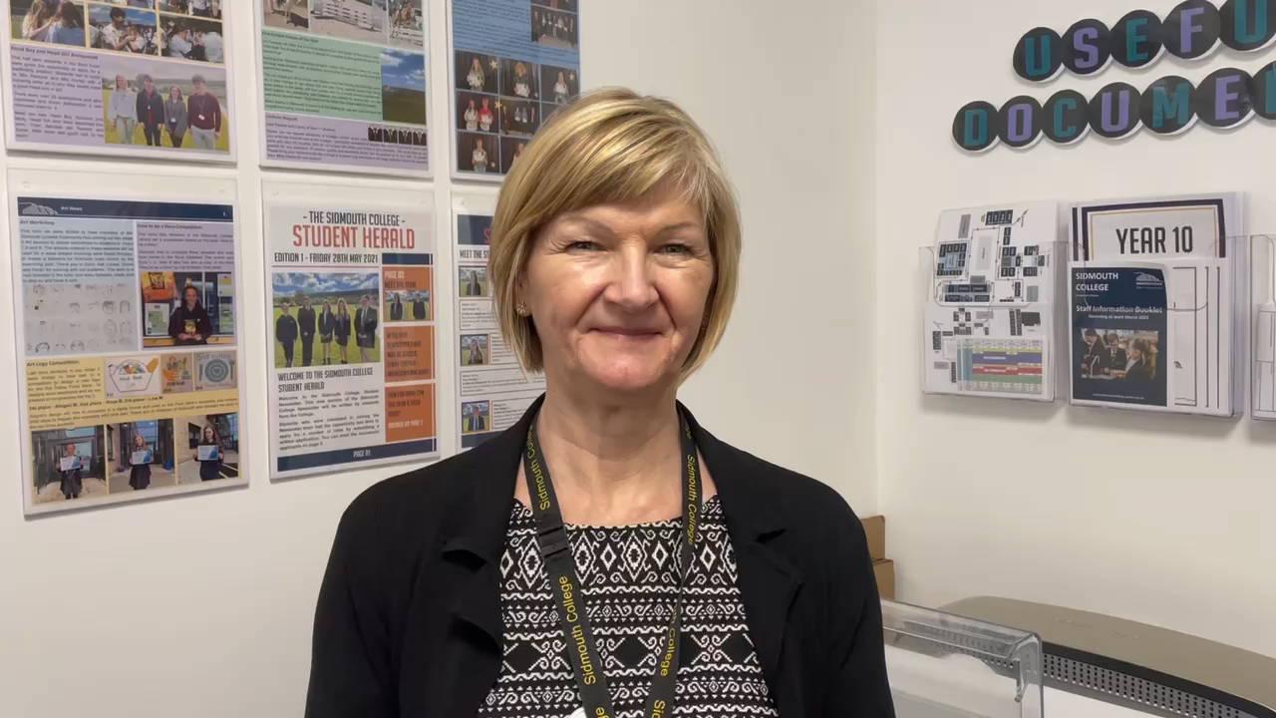

Slide 3
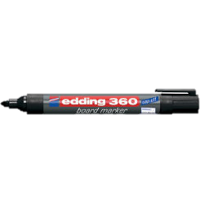

Think of a list of 3 adjectives that describe you…
Clever
Freckly
Quirky
Tall
Athletic
Funny

Slide 4
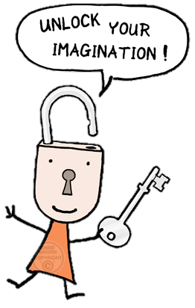
What we are doing today
Lesson Objective:
To write about ourselves in an unusual and creative way.
Produce a competition entry.
Imagining

Slide 5
I am
July 2021
Imagining

Slide 6

Write the following list on the left side of your paper.
Colour
Animal
Food
Place
Time of day
Sport or hobby
Flower or plant
Clothing
Famous building

Slide 7

What next?
Imagine you are these items
What would you be?
Write one or two ideas next to each item on the list
Don’t take too long – just do it as quickly as you can!
Imagining

Slide 8

What would I choose?
What have you got?
Colour
Animal
Food
Place
Time of day
Sport or hobby
Flower or plant
Clothing
Famous building
Emerald Green
Panther
Fish & Chips
Liverpool
Dusk
Swimming
Sunflower
Mittens
The Liver Buildings

Slide 9

Now think why you are like that item – write it in a third column
item | choice | Link
colour | red | Short tempered and dangerous
Flower | sunflower | Tall and bright – everyone looks at me!
Food | Fish and chips | Hot and tasty – very popular!
Making links

Slide 10
Put everything together - using the format below- to create a poem about you
(you can change the order if you like).
I am a …
I am a …
Like a ….., I
Sometimes, I am like a … when I
Sometimes, I … like a …
I am a
I am

Slide 11
For example
I am a panther - sleek and dangerous.
I am an emerald: as deep and impenetrable as a jungle.
Like a ….., I
Sometimes, I am like a … when I
Sometimes, like chilli, I am fiery.
I am a
I am dusk; I am a moment where daylight and darkness collide!

Slide 12

Add a simile
What is a simile?
It is a comparison using the words ‘like’ or ‘as’.
For example – Like a panther, I am sleek and dangerous!
Add to your writing

Slide 13
Add a metaphor
What is a metaphor?
It is a comparison where we say one thing is another.
For example – I am a sunflower; I am tall and bright. Everyone notices me.
You write one!

Slide 14
Try out some ideas…
Draft your piece until you are happy with it! Email your finished piece to alucas@sidmouthcollege.devon.sch.uk
by 1st September 2021
There will be prizes in September!

