Slide 1
DRAMA OBJECT PUPPET SHOW
July 2021

Slide 2
Bring in 2 everyday objects from home that you will add some human features to

Slide 3
Think about what characters they could be and find objects you think will connect to each other as friends or enemies

Slide 4
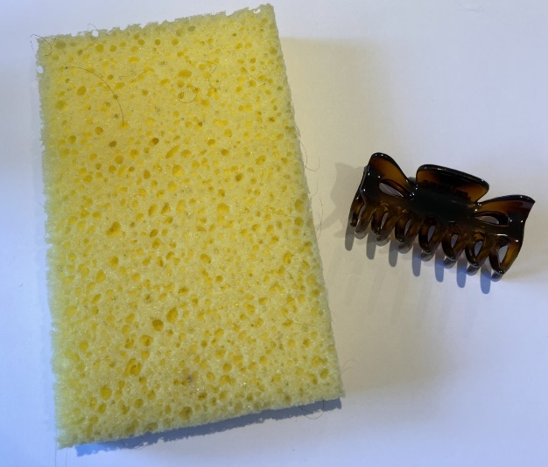
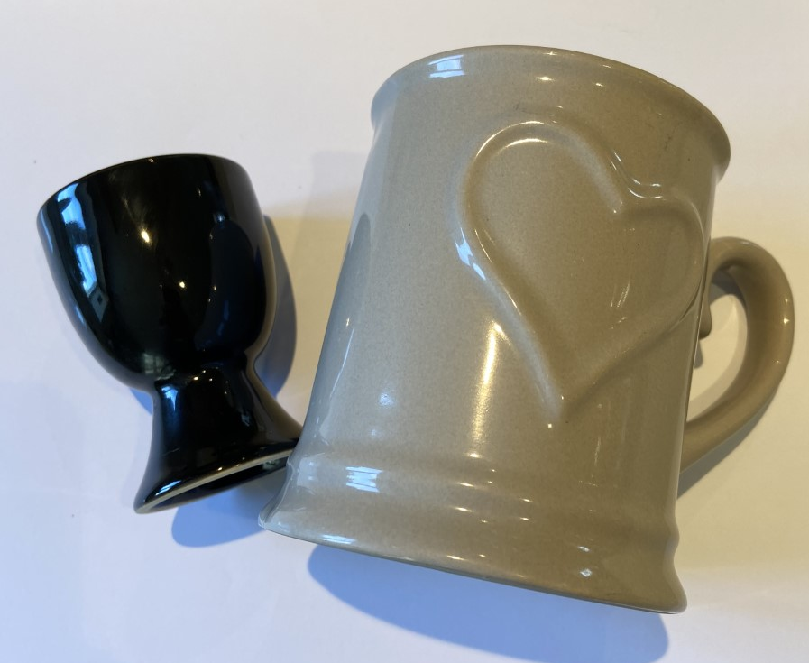
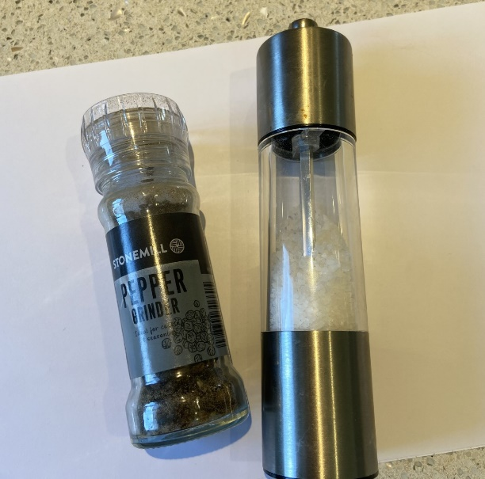
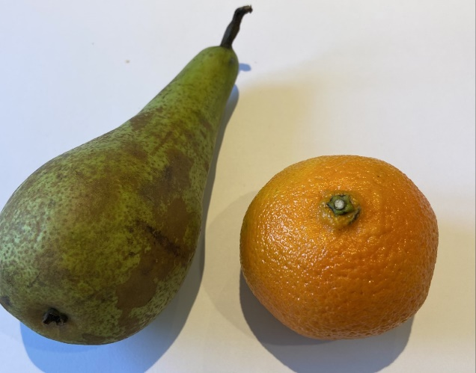
Here are some examples

Slide 5
You will be making them into puppets with personalities and using your voice and moving them to bring them to life

Slide 6
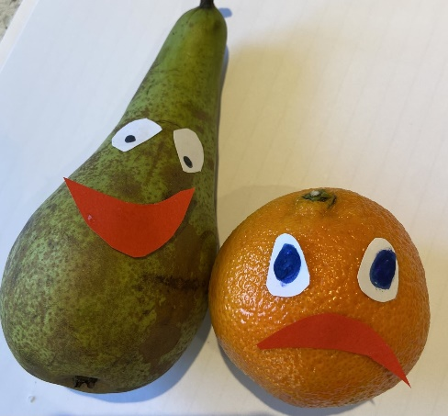
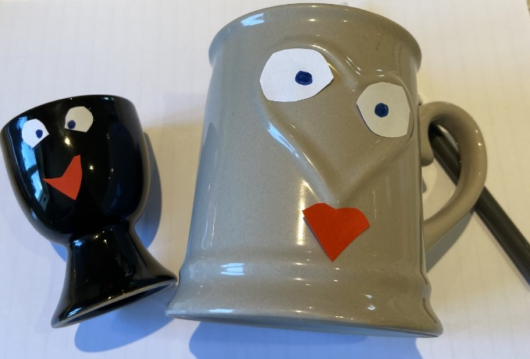
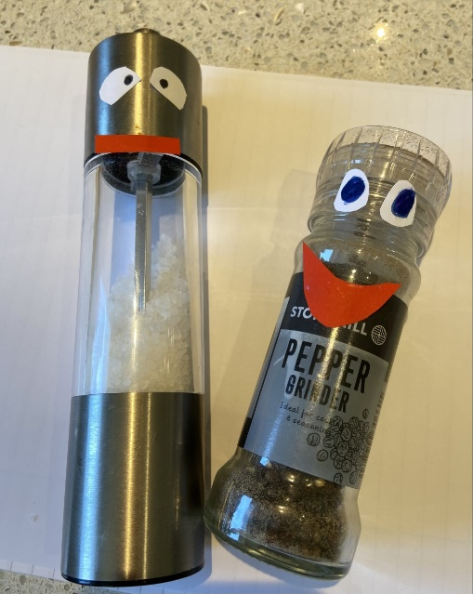
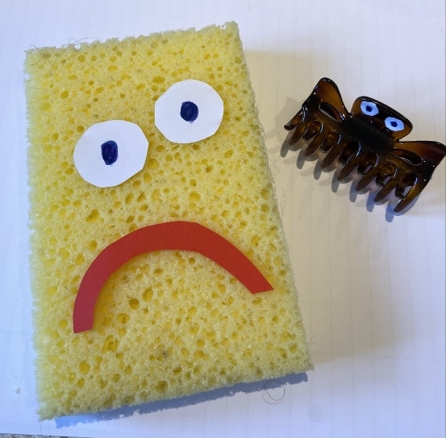
This is what we did with the examples to give them human qualities

Slide 7
Warning
Do not decorate them at home!

Slide 8
DRAMA OBJECT PUPPET SHOW

Slide 9
CREATE YOUR CHARACTERS

Slide 10
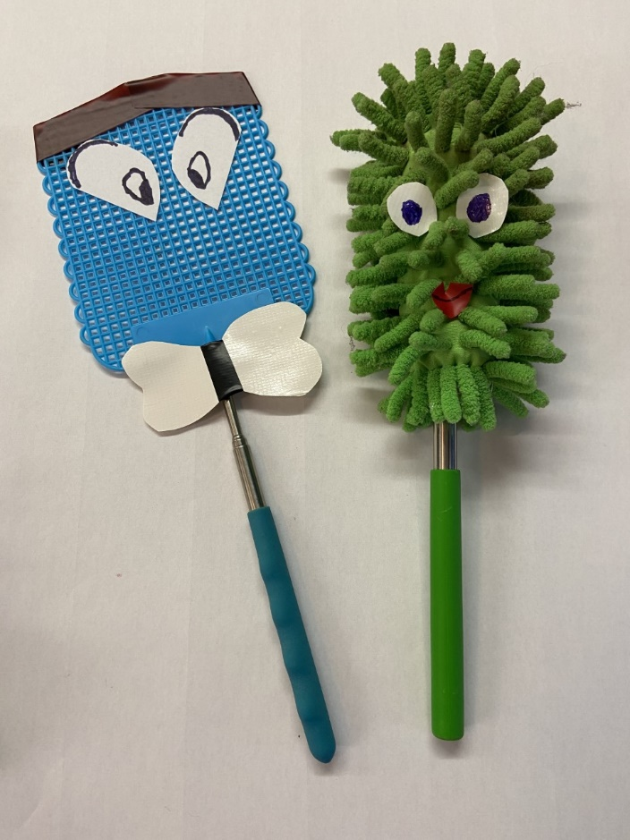
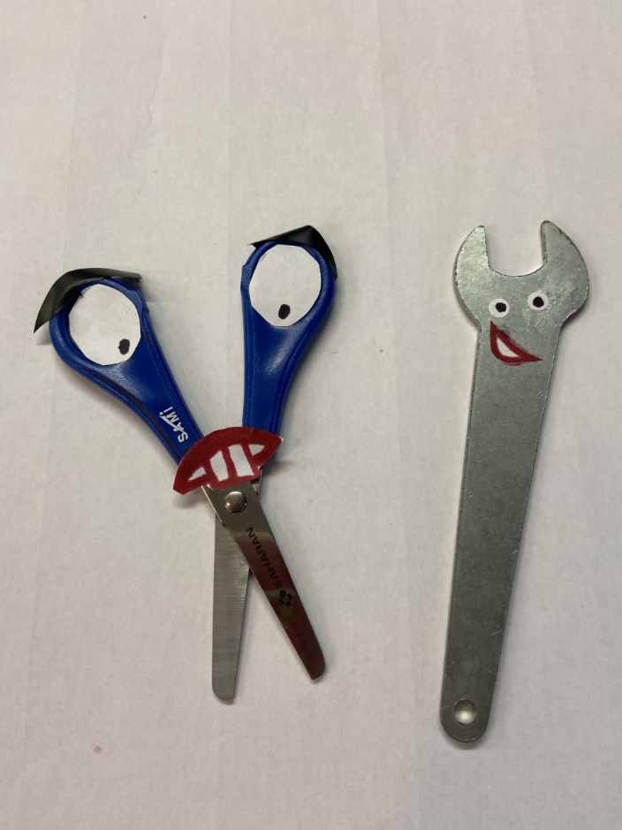
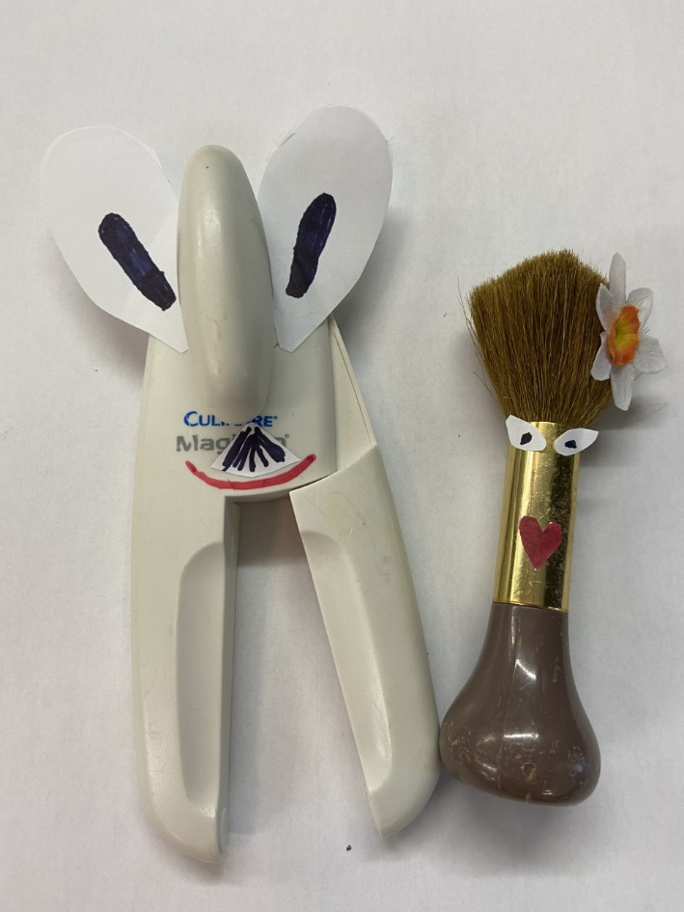
Here are some we created!

Slide 11
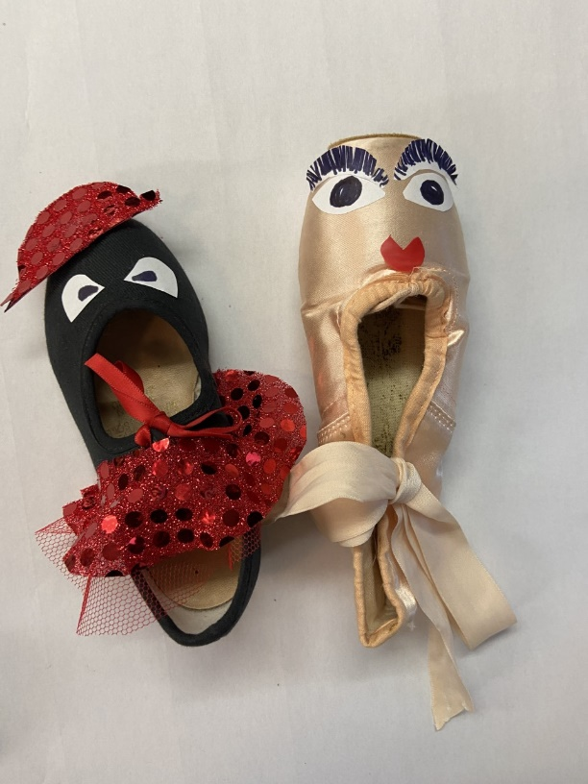
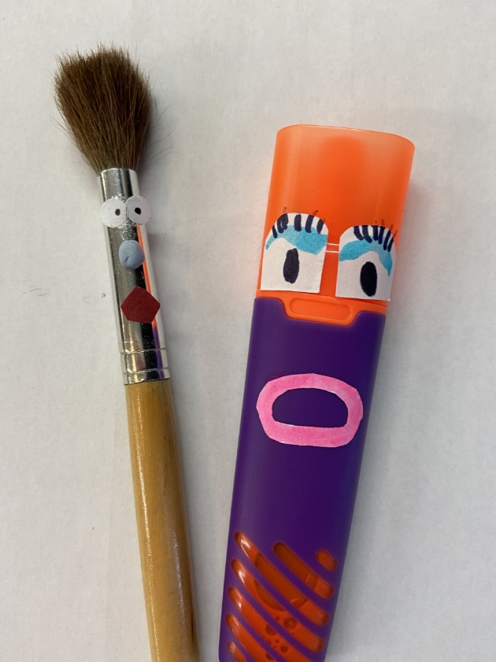

Slide 12
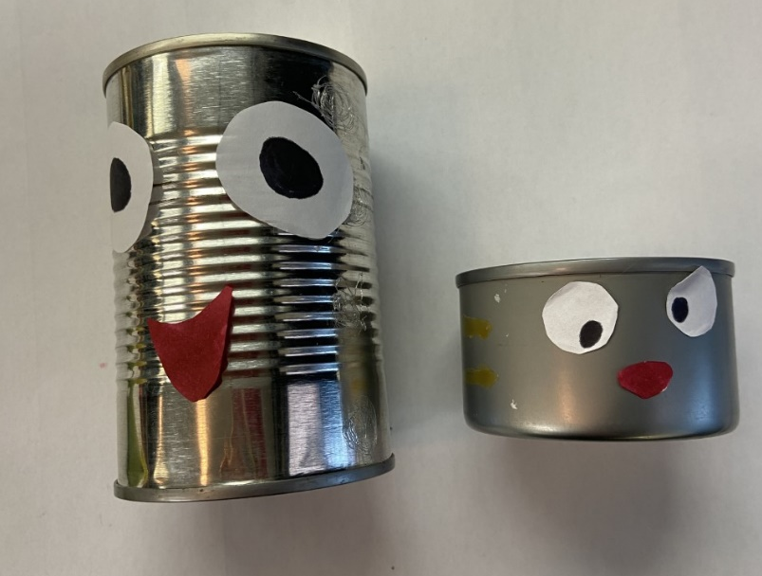

Slide 13
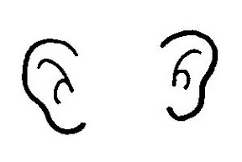
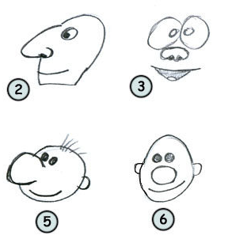
Using the resources available create interesting characters
Add
Or your own ideas!

Slide 14
Now bring your object characters to life
by
giving them a type of voice, movement and an attitude

Slide 15
Now create your scenes
Decide on a location and a situation for your characters to be in

Slide 16
Try out lots of ideas and mix your characters.
Can you create a scene that features all of your object puppets?

Slide 17
Rehearse rehearse rehearse

Slide 18
Perform
Choose your best and most entertaining scene
And perform to the class

Slide 19
GOOD LUCK
WE HOPE YOU HAVE ENJOYED THIS ACTIVITY AND WE LOOK FORWARD TO MEETING YOU NEXT TERM IN YOUR DRAMA LESSONS

