Slide 1
History Department
Learning about the past to shape our present and future.

Slide 2
Introduction Video

Slide 3
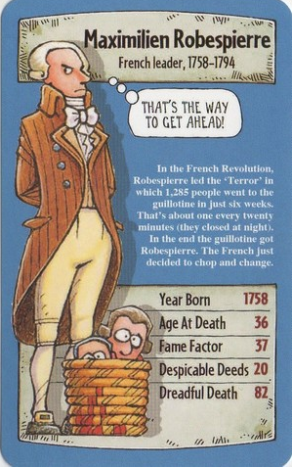
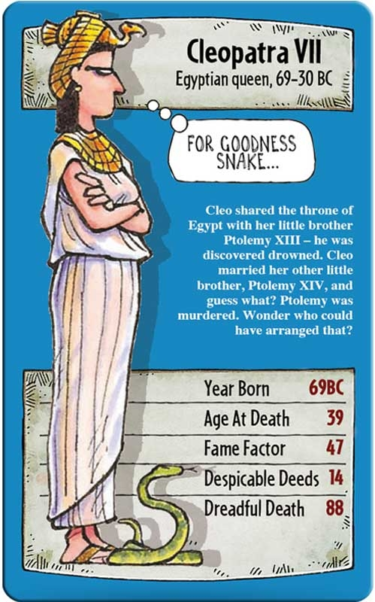
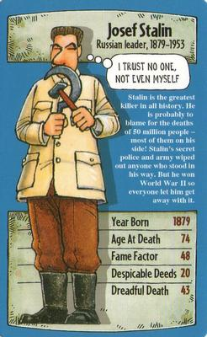
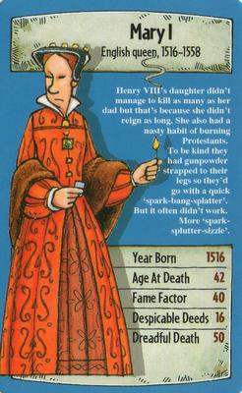
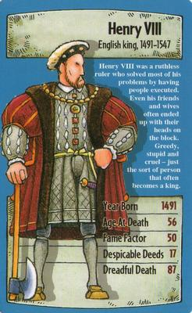
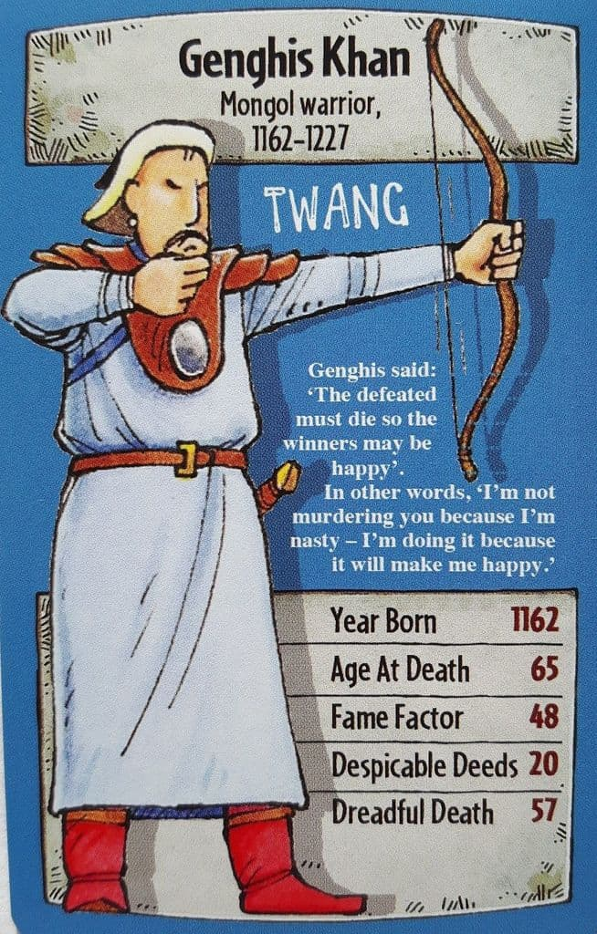
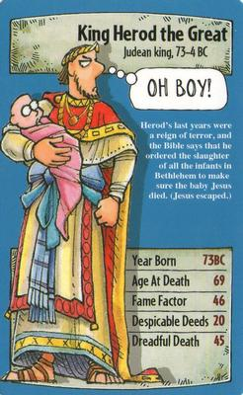
The Task
Ever wondered who you think is the most significant person in History. Ever considered what event is the most important in History. Now is your opportunity to produce the answers. We will be offering you, the students, the opportunity to work in pairs to plan and create a set of top trumps. These will then be used by yourself and others to answer the questions; who or what it the most significant person or event in History.

Slide 4
Learning Objective and Success Criteria
Learning Objective
To explore the idea of significance within History.
Success Criteria
All students will design and produce a set of 12 Top Trumps.
Most students will produce criteria to be able to assess the importance of individuals or events.
Some students will judge which is the most significant individuals or event.

Slide 5
Sequence of Learning
You need to get into pairs.
Your teacher could show some examples of Top Trumps.
Your teacher will discuss ideas for a criteria for assessing significance.
You need to work in a pair to select 12 individuals / events.
You need to produce criteria.
You need to produce cards.
You need to print the cards and ask your teacher to laminate the cards.

