Slide 1

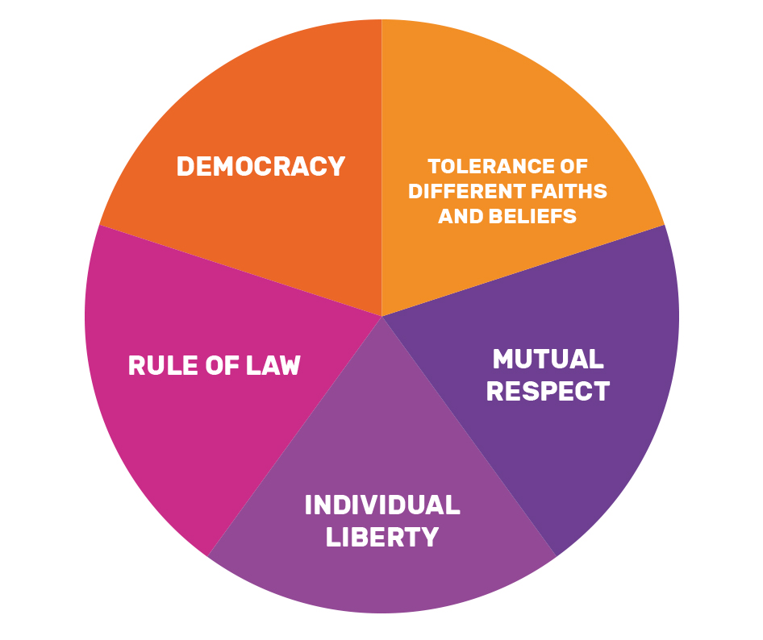
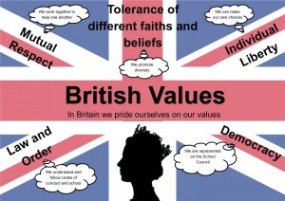

British Values!

Slide 2

What are British Values?

Slide 3
What are British Values?
According to Ofsted, 'fundamental British values' are:
democracy
the rule of law
individual liberty
mutual respect for and tolerance of those with different faiths and beliefs and for those without faith.

Slide 4
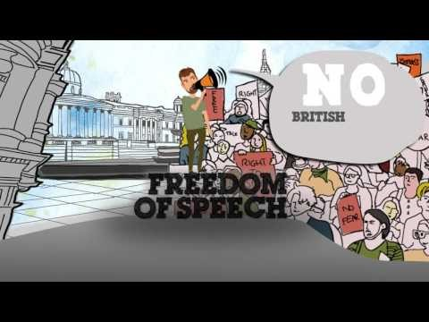
Notes:
https://www.youtube.com/watch?v=Wk1vGq_J4D0

Slide 5
Your Schools responsibility to British values

Slide 6
Your Schools responsibility to British values
To enable students to develop their self-knowledge, self-esteem and self-confidence
To enable students to distinguish right from wrong and to respect the civil and criminal law of England
To encourage students to accept responsibility for their behaviour, show initiative, and to understand how they can contribute positively to the lives of those living and working in the locality of the school and to society more widely
To enable students to acquire a broad general knowledge of and respect for public institutions and services in England
To teach further tolerance and harmony between different cultural traditions by enabling students to acquire an appreciation for and respect for their own and other cultures
To encourage respect for other people
To encourage respect for democracy and support for participation in the democratic processes, including respect for the basis on which the law is made and applied in England.

Slide 7
Your responsibility to British values

Slide 8
Your responsibility to British Values
Have an understanding of how citizens can influence decision-making through the democratic process
Have an appreciation that living under the rule of law protects individual citizens and is essential for their wellbeing and safety
Have an understanding that there is a separation of power between the executive and the judiciary, and that while some public bodies such as the police and the army can be held to account through Parliament, others such as the courts maintain independence;
Have an understanding that the freedom to choose and hold other faiths and beliefs is protected in law;
Have an acceptance that other people having different faiths or beliefs to oneself (or having none) should be accepted and tolerated, and should not be the cause of prejudicial or discriminatory behaviour; and
Have an understanding of the importance of identifying and combatting discrimination.

Slide 9
Democracy
A democracy is a system of government by the whole population or all the eligible members of a state, typically through elected representatives.
A functioning democracy is the form of government that provides its citizens with the most freedom, the most opportunity, the greatest prosperity, and the most comfortable life. It is also the most stable.

Slide 10
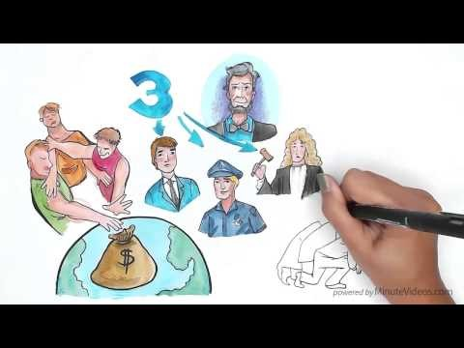
Notes:
https://www.youtube.com/watch?v=u6jgWxkbR7A

Slide 11
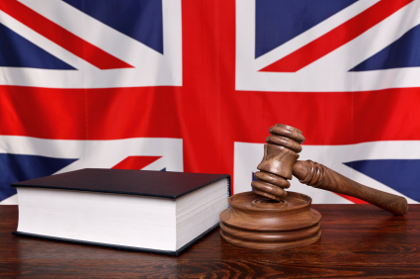
British Law
Law is the system by which a society is regulated. It consists of rules with regard to behaviour, both at the time of action and the steps taken to rectify an unlawful action.
If there were no laws, then people could do anything they wished, a situation called anarchy. A state of anarchy becomes problematic when society is unable to function because everyone operates according to their own desires. Imagine a world without law; you would be open to all manner of abuse.

Slide 12
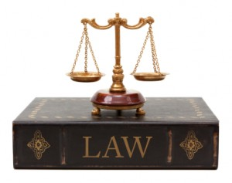
Why do we need Law?
There are many reasons why we need law:
To regulate society
To protect people
To enforce rights and to solve conflicts.
Laws prevent or deter people from behaving in a manner that negatively affects the quality of life of other people

Slide 13
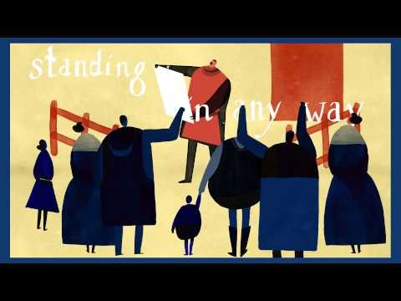
Notes:
https://www.youtube.com/watch?v=7xo4tUMdAMw

Slide 14
Diversity in Britain
Britain is a beautifully diverse place with many different cultures, ethnicities and religions residing here.
Cultural diversity is important because our country, workplaces, and schools increasingly consist of various cultural, racial, and ethnic groups. We can learn from one another, but first we must have a level of understanding about each other in order to facilitate collaboration and cooperation.
Celebrating diversity means an acknowledgement of racial, religious, gender, ethnic, philosophical and cultural differences.

Slide 15
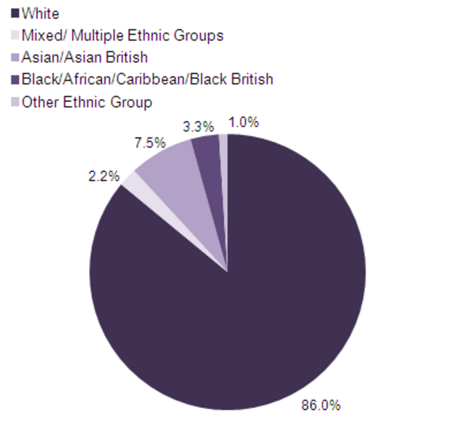

Slide 16
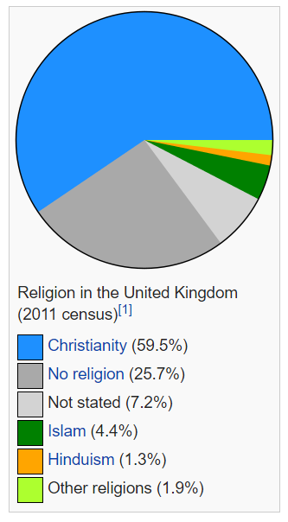
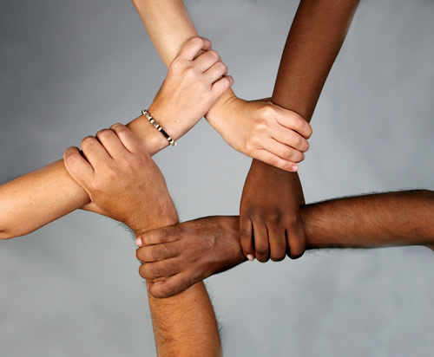


Slide 17

Freedom of speech
Freedom of speech definition. The right to speak without censorship or restraint by the government.
We have the right to give our opinion but we have the responsibility to voice that opinion appropriately, without hate and to listen to other peoples opinions.

Slide 18
Retrieval
What are the British Values?
What would happen without law?
Why is a democracy important?
How important is diversity and respecting other people’s beliefs?

Slide 19
Activity
Class Debates.
Choose a topic for your class to debate. Once you have your topic, decide on your side and argue for and against.
Britain does not need a Prime Minister OR Britain DOES need a Prime Minister? (WW)
Law is needed in Britain OR Law is not needed in Britain
(HXK)
Only one religion should be allowed in Britain OR All religions should be allowed in Britain

