Slide 1
Sidmouth College
Monday 10th October

Slide 2
Our Journey and Sidmouth College

Slide 3
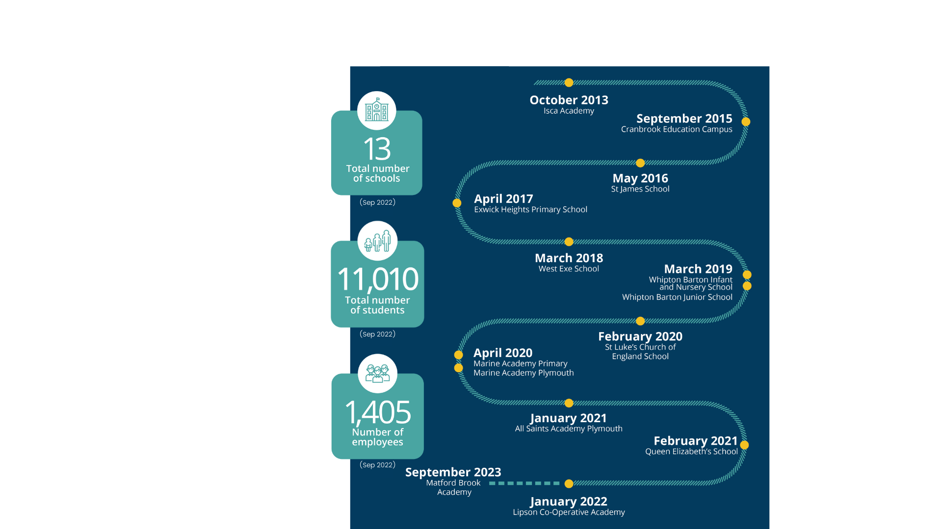
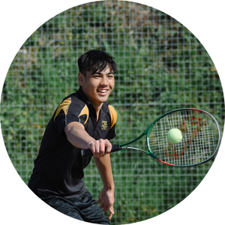
Our Journey and Sidmouth College

Slide 4
Our Journey and Sidmouth College

Slide 5
Who are we?

Slide 6
Notes:
Support Sarah to strengthen communities even further

Slide 8
Notes:
Ambitious for and of our communities; Leadership team at Sidmouth embody this drive
Selflessness; making choices in the best interests of the children
Collaboration; we are stronger together, we know that some fundamental barriers to children’s education won’t change unless we work together

Slide 10
Collaboration
Benefits
Working collaboratively on a formal basis with other strong schools in the region whose values are aligned
Strong professional development at all levels
Having high- quality professional networks
Being stronger together; collective power to tackle the big issues
Financial resilience
Efficiencies in procurement through collective resourcing
Human resource (to support with unexpected vacancies/ absence)
Access to national strategic partners to support our outward facing agenda

