Slide 1
Science at Sidmouth College
Year 6

Slide 2
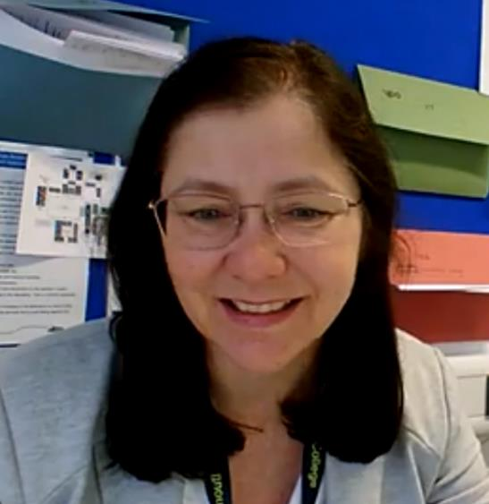
Welcome to Sidmouth Science
Watch this youtube clip to hear an introduction for Mrs Ritchie – the head of science at Sidmouth College.
https://youtu.be/yClS8-cfB3Q

Slide 3
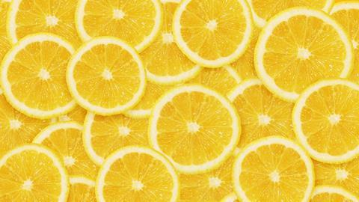
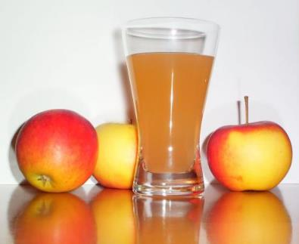
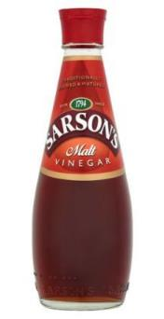
What have these got in common?
These are all examples of acids
Notes:
These are all acids.

Slide 4
Acids all taste sour and react in similar ways.
It important not to find out if something is an acid by tasting it! It might be dangerous.

Slide 5
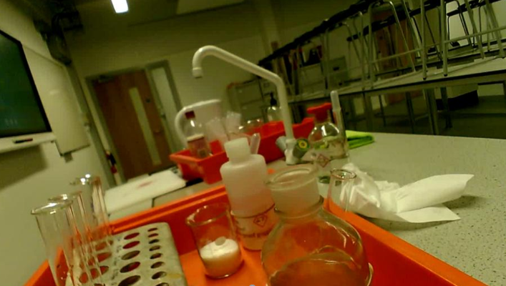
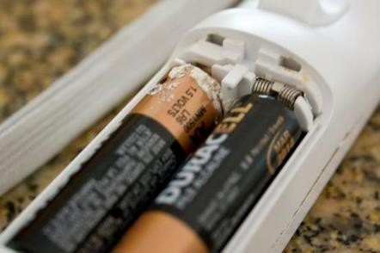
Some acids are dangerous!
https://youtu.be/5QWTe2Bl_sk

Slide 6
What is the opposite of an Acid?
The opposite to an acid is called an alkali. They would be alkaline.

Slide 7
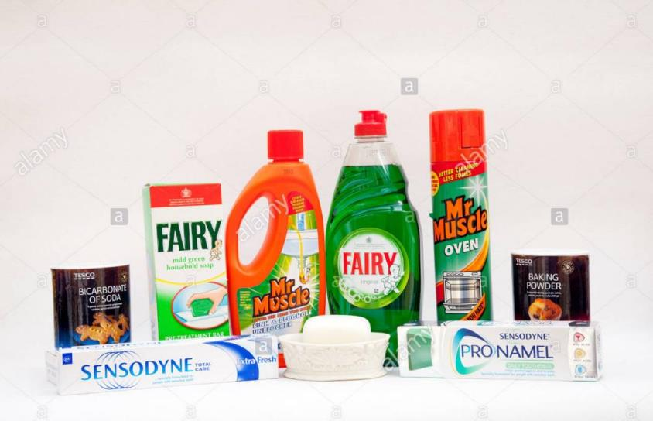
These substances are all alkaline. They all react in similar ways.

Slide 8
Some alkali’s are dangerous.
It important not to find out if something is an alkali by tasting it! It might be dangerous.

Slide 9
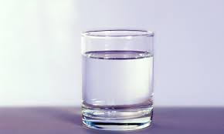
Some substances are neither acid or alkali
Water is a neutral substance.

Slide 10
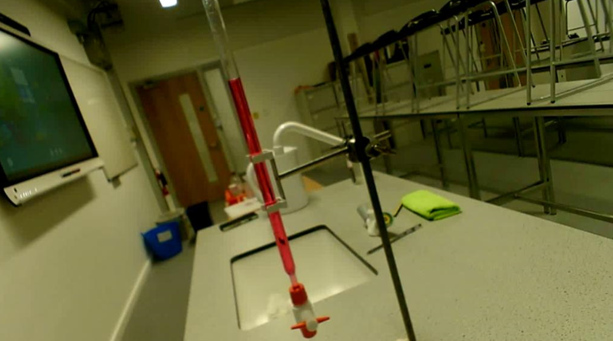
We can react an acid and an alkali together.
This is called a neutralisation.
https://youtu.be/NichmACfn_g

Slide 11
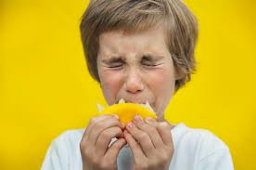
So how can we find out if a substance is an acid, an alkali or neutral?
Would this be a good idea?
Notes:
Remind students that some acid and alkalis are dangerous.

Slide 12
We can use an indicator
There are lots of different indicators but the most commonly used is Universal Indicator
https://www.youtube.com/watch?v=GRNslAaXu9k

Slide 13
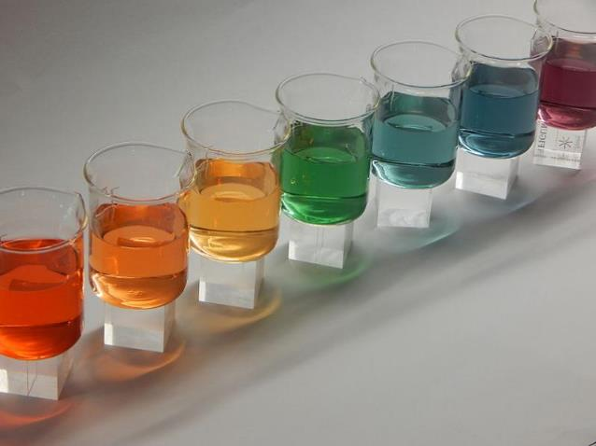
The universal indicator solution changes colour depending on whether the chemical is an acid or an alkali

Slide 14
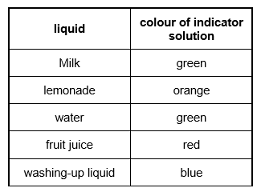
Can you solve the problem?
Are these substances acid, alkali or neutral?

Slide 15
Can you solve the problem?
Are these substances acid, alkali or neutral?
Neutral
acid
neutral
acid
alkali

Slide 16
Battery acid, Lemonade and fruit juice are all acids
What do you think is different about them?
Why do you think it is important that we label acids and alkalis with hazard symbols (like these).
Notes:
Acids can be strong (like battery acid) or weak ( like fruit juices).
Battery acid would be very corrosive and dangerous.

Slide 17
Battery acid, Lemonade and fruit juice are both acids
What do you think is different about them?
Hazard symbols mean we can easily see if a chemical is dangerous – even if we can’t read.
Battery acid would have a corrosive hazard symbol because it is a strong acid
You could get an irritant hazard symbol on fruit juice because it is a weak acid (but probably not).
Notes:
Acids can be strong (like battery acid) or weak ( like fruit juices).
Battery acid would be very corrosive and dangerous.

Slide 18
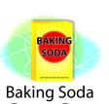
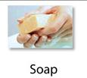
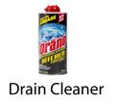
The pH scale
Instead of talking about colours the acidity or alkalinity of a substance can be placed on a scale. Where do you think you’d place these chemicals?
Notes:
Ask students to move the pictures to the right place on the scale.

Slide 19
Were you right?

Slide 20
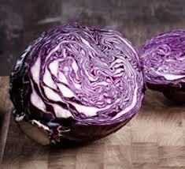
We are going to make an indicator.
The cells of some plants contain a chemical pigment called anthocyanin.
If we cut up the plant and damage the cells we can extract (get out) this pigment.

Slide 21
Safety Make sure you have an adult to help you. Be careful with knives and hot water. Avoid getting chemicals in your eyes. Wear glasses if you possible If you get chemicals in your eye wash your eye with water. Wash your hands carefully after the experiment. Never taste chemicals

Slide 22
Equipment
An responsible adult to help you
Plant material
Knife
Hot water
A weak acid (e.g. white vinegar or lemon juice).
A weak alkali (e.g. sodium bicarbonate (baking powder) mixed with water.
Coffee filter, blotting paper or kitchen towel

Slide 23
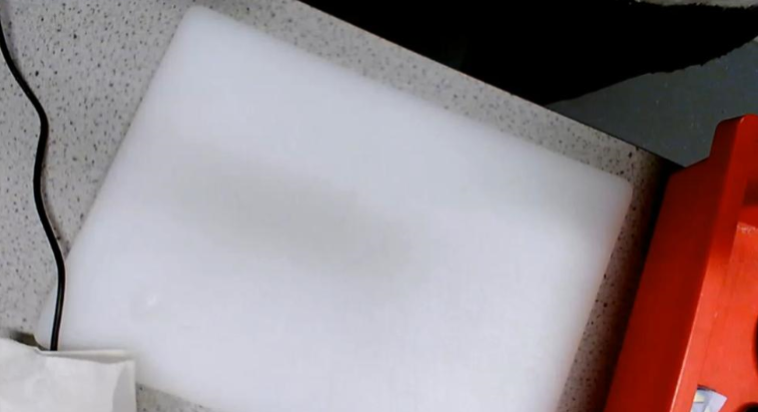
Making the indicator
https://youtu.be/gSTrGUGpvTk

Slide 24
Adding hot water breaks up the membranes and helps us extract the pigment.

Slide 25
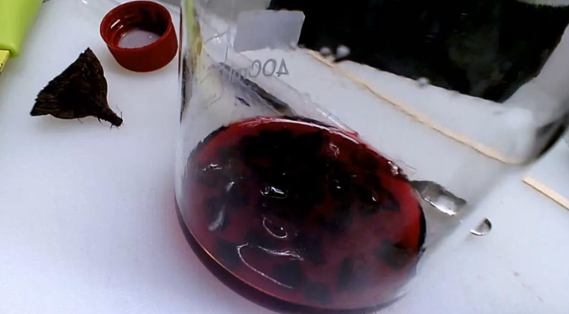
Using the indicator
https://youtu.be/ppDjTKuLArU

Slide 26
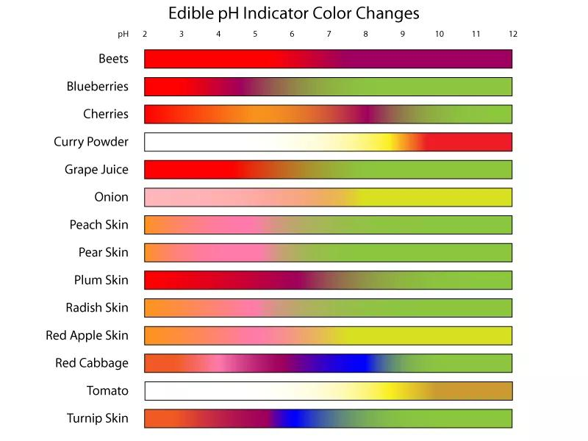
Lots of different plants can be used to make an indicator.
Acids
Alkalis

Slide 27
What colours did your red cabbage go?
Chemical added | Acid, alkali or neutral | Colour with red cabbage indicator
Lemon juice | Acid
Bicarbonate of soda | Alkali
Water | Neutral
Extension:
Evaluate your indicator. Do you think your red cabbage indicator is as useful as universal indicator?

Slide 28
Write a method for next years students
Include photos.
How could your method be improved?
Try some other foods. Which food do you think makes the best indicator? Explain why.
You can send your results to me at :- jritchie@sidmouthcollege.devon.sch.uk
Submissions need to be sent by Monday 12th July please

Slide 29
Extension Activity

Slide 30
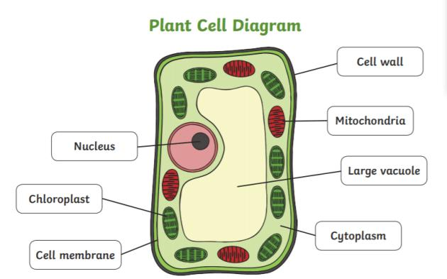
All living things are made from cells.
Plant cells have a large vacuole. The pigment is found inside the vacuole.
Click here if you want to know more about cells
Click here to find out more about how cells were discovered

Slide 31
Produce a model of an animal cell
Label the parts
What does each part do?

