Slide 1
Home Learning Year 8 – Football (Week 2 of self isolation)

Slide 2
STARTER – What can you recall from week 1?
Sidmouth College
Can you name all 12 components of fitness?
Flexibility
Strength
Cardiovascular endurance
Muscular endurance
Balance
Agility
Co-ordination
Power
Reaction Time
Speed
Static Strength
Maximal strength

Slide 3
STARTER – What can you recall from week 1?
Sidmouth College
How many did you get?
Flexibility
Strength
Cardiovascular endurance
Muscular endurance
Balance
Agility
Co-ordination
Power
Reaction Time
Speed
Static Strength
Maximal strength

Slide 4
STARTER – What can you recall from week 1?
Sidmouth College
How many definitions can you recall?
Flexibility | The range of movement possible at a joint.
Strength | The ability to overcome a resistance.
Cardiovascular endurance | Ability of heart and lungs to supply oxygen to the working muscles.
Muscular endurance | The ability of muscles to undergo repeated contractions, avoiding fatigue.
Balance | The maintenance of the centre of mass over the base of support.
Agility | The ability to move and change direction quickly whilst maintain control.
Co-ordination | The ability to use two different parts of the body together smoothly and efficiently.
Power | Product of strength and speed, also known as explosive strength (anaerobic power).
Reaction Time | The time taken to initiate a response to a stimulus.
Speed | Putting the body parts through actions as quickly as possible.
Static Strength | Ability to hold a body part in a static position.
Maximal strength | The largest force possible in a single maximal contraction.

Slide 5
STARTER – What can you recall from week 1?
Sidmouth College
How many definitions did you get?
Flexibility | The range of movement possible at a joint.
Strength | The ability to overcome a resistance.
Cardiovascular endurance | Ability of heart and lungs to supply oxygen to the working muscles.
Muscular endurance | The ability of muscles to undergo repeated contractions, avoiding fatigue.
Balance | The maintenance of the centre of mass over the base of support.
Agility | The ability to move and change direction quickly whilst maintain control.
Co-ordination | The ability to use two different parts of the body together smoothly and efficiently.
Power | Product of strength and speed, also known as explosive strength (anaerobic power).
Reaction Time | The time taken to initiate a response to a stimulus.
Speed | Putting the body parts through actions as quickly as possible.
Static Strength | Ability to hold a body part in a static position.
Maximal strength | The largest force possible in a single maximal contraction.

Slide 6
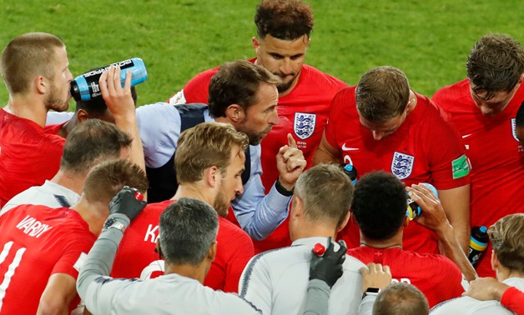
What am I learning today?
Sidmouth College
LO:
To notice detail on technique for skills in football.
Success criteria:
Identify the technical points for a skill
Explain how it helps perform that skill
Analyse the technique of a performer for a skill

Slide 7
Core skills
Sidmouth College
FOOTBALL CORE SKILLS
Passing/receiving
Dribbling/moving with the ball
Shooting
Heading
Tackling

Slide 8
Core skills
Sidmouth College
FOOTBALL CORE SKILLS
Shooting
What types of shots can you see in this video?
https://www.youtube.com/watch?v=MeOy4ubmrGI

Slide 9
Shooting
Sidmouth College
At year 8, we would expect you to be able to start shooting with accuracy to beat the goalkeeper and score goals. Watch the video below and answer the questions on the next slide.
https://www.youtube.com/watch?v=e3cdiSWpxC0

Slide 10
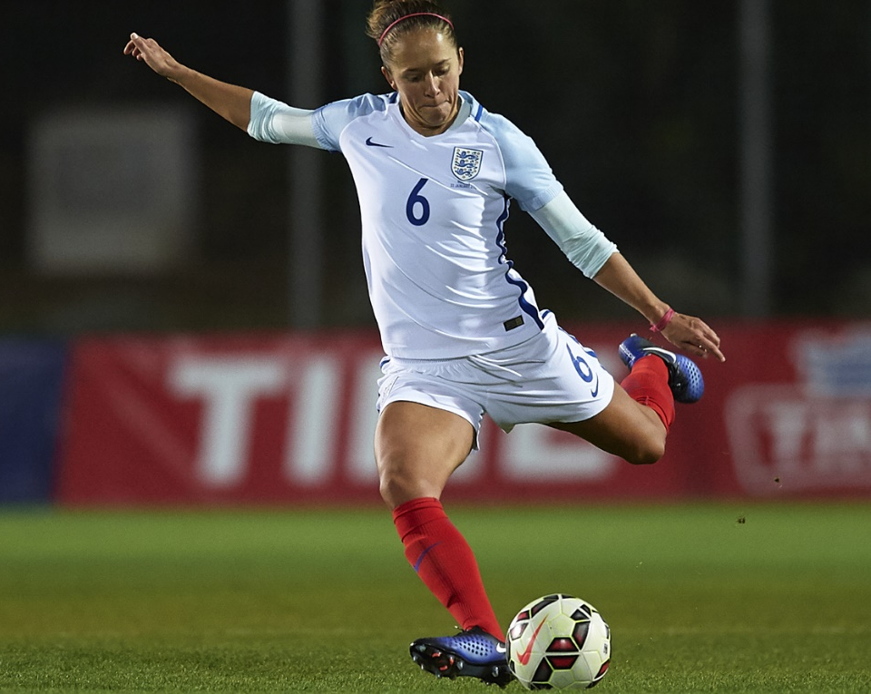
Shooting
Sidmouth College
Why should your head be over the ball when you shoot?
Which surface/part of the foot should you use if you wanted to curl the ball?
Which surface/part of the foot should you use if you wanted to drive the ball with power?
Why might it be a good idea to shoot/aim for the corners.
How does taking a touch away from your body help when shooting?

Slide 11
Core skills
Sidmouth College
FOOTBALL CORE SKILLS
Tackling
What makes an effective defender?
https://www.youtube.com/watch?v=ETx2N4PXjoM

Slide 12
Tackling
Sidmouth College
At year 8, we would expect you to be able to defend in 1v1 situations using the correct technique. Watch the video below and answer the questions on the next slide.
https://www.youtube.com/watch?v=6hANxNGEtkg

Slide 13
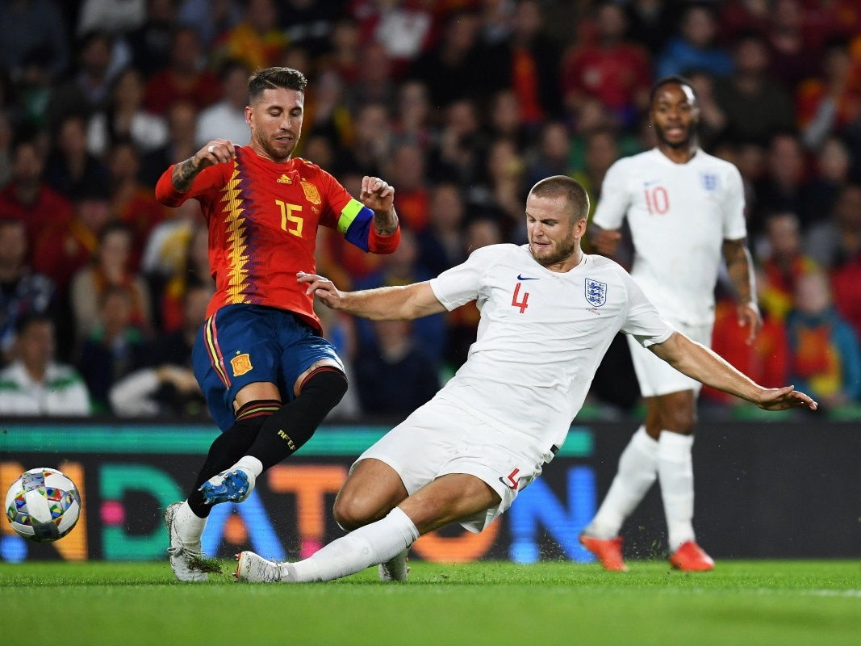
Tackling
Sidmouth College
Should you be front on or side on when defending 1v1? (Justify why)
Why is it a good strategy to force an attacker onto their weaker foot?
State two rules of tackling.
Why should defenders stay low whilst defending 1v1?
How does using your upper body help you make a tackle?

Slide 14
What am I learning today?
Sidmouth College
LO:
To notice detail on technique for skills in football.
Success criteria:
Identify the technical points for a skill
Explain how it helps perform that skill
Analyse the technique of a performer for a skill
Submit your answers to your teacher!

