Slide 1
Home Learning Year 9 – Hockey (Week 1 of self isolation)

Slide 2
What are we learning today
Sidmouth College
LO: Justify the components of fitness and skills needed in hockey.
You will show your learning by…
Identifying the 12 components of fitness
Applying you knowledge of components and hockey skills
Justifying how the components help a hockey performer

Slide 3
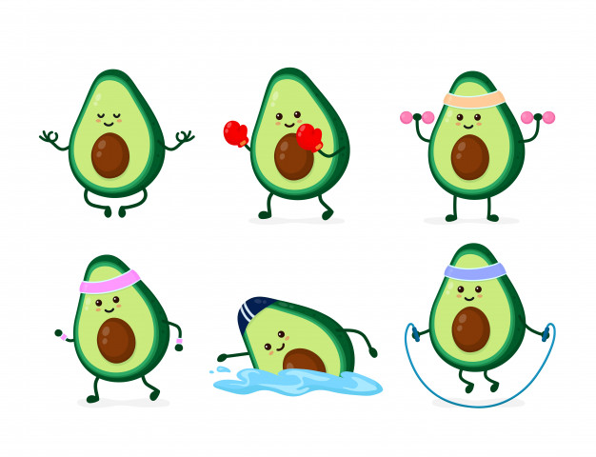
Starter
Sidmouth College
How would you define fitness?

Slide 4
Starter
Sidmouth College
Fitness is defined as the ability to cope with the demands of the environment.

Slide 5
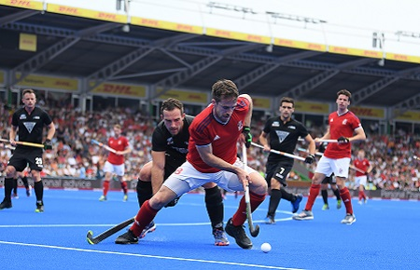
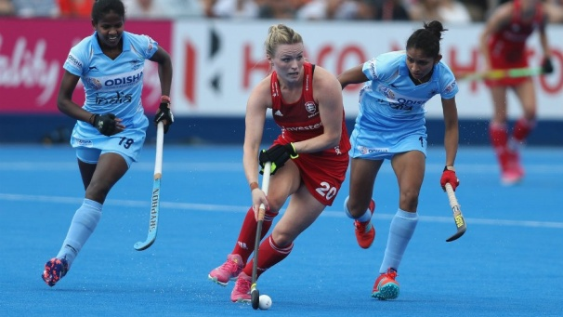
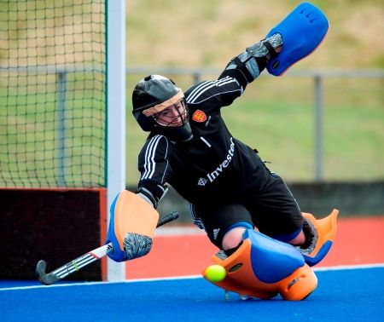
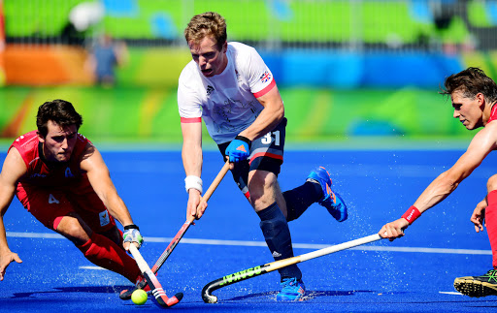
Components of fitness
Sidmouth College
Fitness is made up of different components, which allow you to be able to perform physical activity in different ways.
Different positions in hockey require different components of fitness.

Slide 6
What are the components of fitness?
Sidmouth College
Match up the component of fitness to the correct definition
Flexibility | Ability to hold a body part in a static position.
Strength | The ability to move and change direction quickly whilst maintain control.
Cardiovascular endurance | The ability to use two different parts of the body together smoothly and efficiently.
Muscular endurance | The maintenance of the centre of mass over the base of support.
Balance | The ability of muscles to undergo repeated contractions, avoiding fatigue.
Agility | The ability to overcome a resistance.
Co-ordination | Ability of heart and lungs to supply oxygen to the working muscles.
Power | The largest force possible in a single maximal contraction.
Reaction Time | Putting the body parts through actions as quickly as possible.
Speed | The time taken to initiate a response to a stimulus.
Static Strength | The range of movement possible at a joint
Maximal strength | Product of strength and speed, also known as explosive strength (anaerobic power).

Slide 7
Components of fitness definitions
Sidmouth College
How many did you get correct? RED PEN where needed.
Flexibility | The range of movement possible at a joint.
Strength | The ability to overcome a resistance.
Cardiovascular endurance | Ability of heart and lungs to supply oxygen to the working muscles.
Muscular endurance | The ability of muscles to undergo repeated contractions, avoiding fatigue.
Balance | The maintenance of the centre of mass over the base of support.
Agility | The ability to move and change direction quickly whilst maintain control.
Co-ordination | The ability to use two different parts of the body together smoothly and efficiently.
Power | Product of strength and speed, also known as explosive strength (anaerobic power).
Reaction Time | The time taken to initiate a response to a stimulus.
Speed | Putting the body parts through actions as quickly as possible.
Static Strength | Ability to hold a body part in a static position.
Maximal strength | The largest force possible in a single maximal contraction.

Slide 8
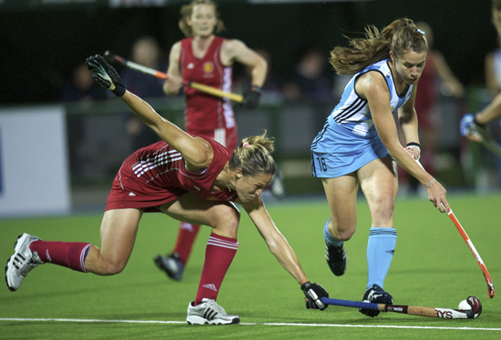
Application to skills and components of fitness in hockey
Sidmouth College
HOCKEY SKILLS
Passing
Receiving
Dribbling/moving with the ball
Shooting
Tackling/ jockeying/ marking
FITNESS COMPONENT
Flexibility
Strength
Cardiovascular endurance
Muscular endurance
Balance
Agility
Co-ordination
Power
Reaction Time
Speed
Static Strength
Maximal strength
What skill(s) can you see?
2. What component of fitness can you see? Justify your answer.
(Use the definitions on the previous slide to help)

Slide 9
Example – identify skills
Sidmouth College
Dribbling/moving with the ball
Could you argue any others?
Tackling

Slide 10
Example – justify components of fitness
Sidmouth College
Coordination timing to hit the ball at the correct time
Speed moving as quickly as possible to avoid the tackle
Balance (staying on her feet despite lunging forwards to make the tackle)
Could you argue any others?
Flexibility (flexion at the left hip to reach for the tackle)

Slide 11
Apply to skills in hockey
Sidmouth College
HOCKEY SKILLS
Passing
Receiving
Dribbling/moving with the ball
Shooting
Tackling/ jockeying/ marking
FITNESS COMPONENT
Flexibility
Strength
Cardiovascular endurance
Muscular endurance
Balance
Agility
Co-ordination
Power
Reaction Time
Speed
Static Strength
Maximal strength
What skill(s) can you see?
2. What component of fitness can you see? Justify your answer.
(Use the definitions to help)

Slide 12
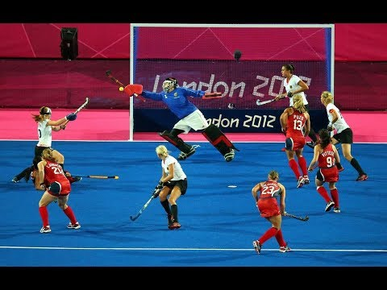
Apply to skills in hockey
Sidmouth College
HOCKEY SKILLS
Passing
Receiving
Dribbling/moving with the ball
Shooting
Tackling/ jockeying/ marking
FITNESS COMPONENT
Flexibility
Strength
Cardiovascular endurance
Muscular endurance
Balance
Agility
Co-ordination
Power
Reaction Time
Speed
Static Strength
Maximal strength
What skill(s) can you see?
2. What component of fitness can you see? Justify your answer.
(Use the definitions to help)

Slide 13
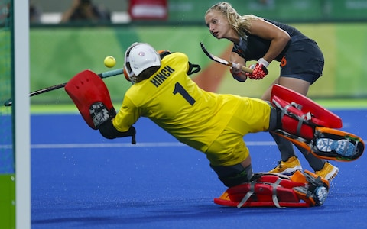
Apply to goalkeeper skills in hockey
Sidmouth College
FOOTBALL (GOALKEEPR) SKILLS
Distribution – kicking/throwing/rolling
Shot stopping
Taking crosses
Taking the ball from an attacker
Positioning and narrowing the angle
FITNESS COMPONENT
Flexibility
Strength
Cardiovascular endurance
Muscular endurance
Balance
Agility
Co-ordination
Power
Reaction Time
Speed
Static Strength
Maximal strength
What skill(s) can you see?
2. What component of fitness can you see? Justify your answer.
(Use the definitions to help)

Slide 14
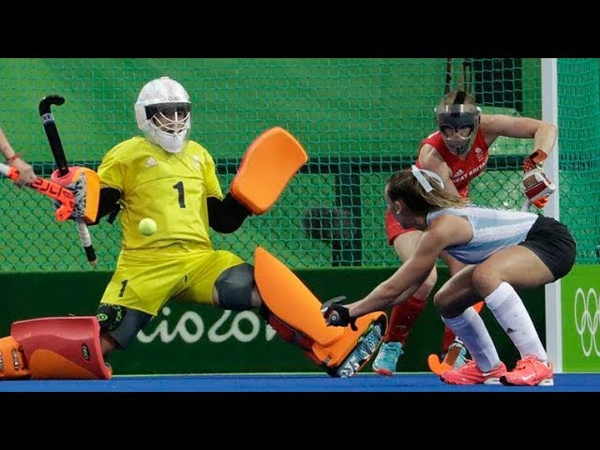
Apply to goalkeeper skills in hockey
Sidmouth College
FOOTBALL (GOALKEEPR) SKILLS
Distribution – kicking/throwing/rolling
Shot stopping
Taking crosses
Taking the ball from an attacker
Positioning and narrowing the angle
FITNESS COMPONENT
Flexibility
Strength
Cardiovascular endurance
Muscular endurance
Balance
Agility
Co-ordination
Power
Reaction Time
Speed
Static Strength
Maximal strength
What skill(s) can you see?
2. What component of fitness can you see? Justify your answer.
(Use the definitions to help)

Slide 15
Plenary – what have you learnt today? Can you beat your first attempt?
Sidmouth College
Match up the component of fitness to the correct definition
Flexibility | Ability to hold a body part in a static position.
Strength | The ability to move and change direction quickly whilst maintain control.
Cardiovascular endurance | The ability to use two different parts of the body together smoothly and efficiently.
Muscular endurance | The maintenance of the centre of mass over the base of support.
Balance | The ability of muscles to undergo repeated contractions, avoiding fatigue.
Agility | The ability to overcome a resistance.
Co-ordination | Ability of heart and lungs to supply oxygen to the working muscles.
Power | The largest force possible in a single maximal contraction.
Reaction Time | Putting the body parts through actions as quickly as possible.
Speed | The time taken to initiate a response to a stimulus.
Static Strength | The range of movement possible at a joint
Maximal strength | Product of strength and speed, also known as explosive strength (anaerobic power).

Slide 16
Plenary – what have you learnt today?
Sidmouth College
How many did you get correct? RED PEN where needed.
Flexibility | The range of movement possible at a joint.
Strength | The ability to overcome a resistance.
Cardiovascular endurance | Ability of heart and lungs to supply oxygen to the working muscles.
Muscular endurance | The ability of muscles to undergo repeated contractions, avoiding fatigue.
Balance | The maintenance of the centre of mass over the base of support.
Agility | The ability to move and change direction quickly whilst maintain control.
Co-ordination | The ability to use two different parts of the body together smoothly and efficiently.
Power | Product of strength and speed, also known as explosive strength (anaerobic power).
Reaction Time | The time taken to initiate a response to a stimulus.
Speed | Putting the body parts through actions as quickly as possible.
Static Strength | Ability to hold a body part in a static position.
Maximal strength | The largest force possible in a single maximal contraction.

Slide 17
Home Learning Year 9 – Hockey (Week 2 of self isolation)

Slide 18
What are we learning today
Sidmouth College
LO: demonstrate an understanding of the rules of hockey
You will show your learning by…
Identify the rules of hockey
Apply your knowledge to different contexts
Justifying why the official has made the decision

Slide 19
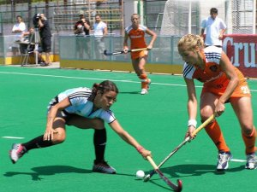
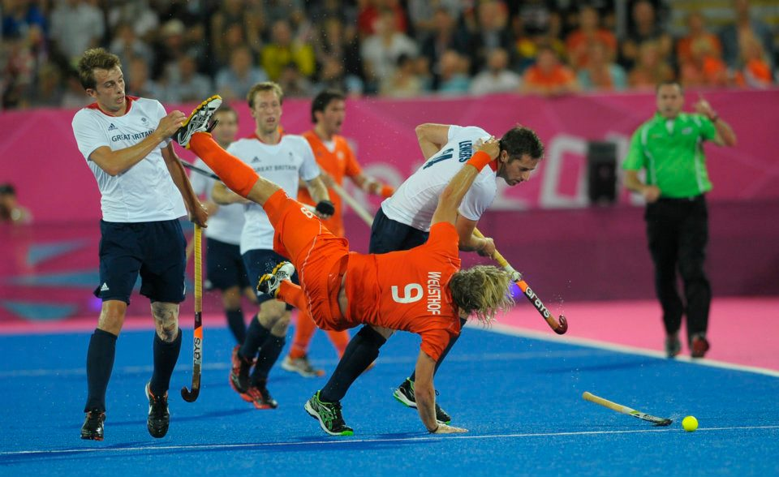
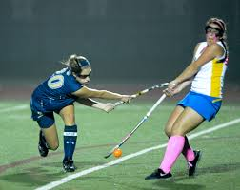
Starter
Sidmouth College
Write down as many hockey ‘fouls’ and ‘infringements’ you can think of.

Slide 20
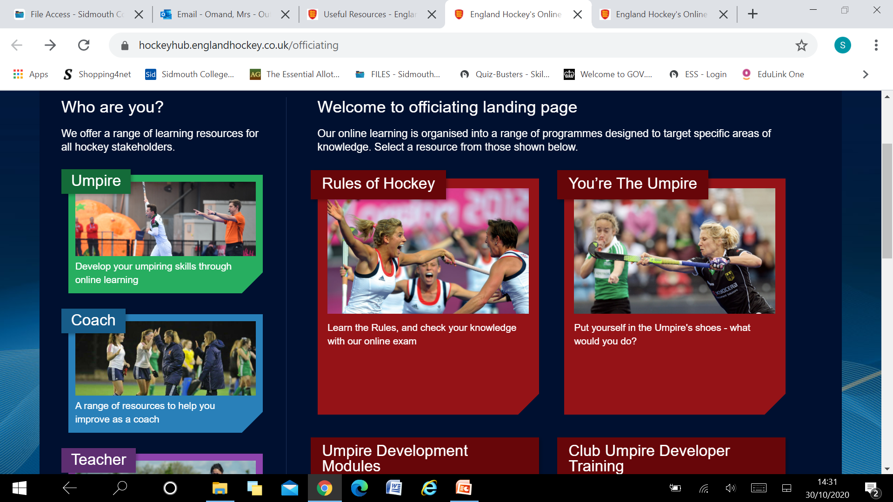
Hockey officiating
Sidmouth College
Go to the following website then click on ‘rules of hockey’ and create an account.
https://hockeyhub.englandhockey.co.uk/officiating

Slide 21
Hockey officiating
Sidmouth College
Complete the officiating award by reading the rules and completing the questions for each section.
Once you have successfully completed each section, it will look like this. Download your certificate and email your teacher a copy!

Slide 22
Hockey officiating – extension task
Sidmouth College
Put your new qualification to use!
Go back to the officiating section and click on ‘You’re the Umpire’.
There are more clips at the bottom of the same page.
https://hockeyhub.englandhockey.co.uk/youretheumpire

Slide 23
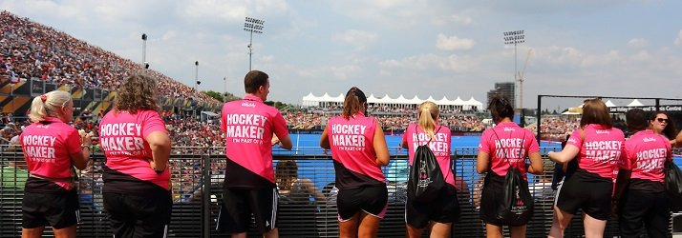
Plenary
Sidmouth College
Email your certificate to your teacher.
Hockey club will start after Christmas – extend your learning further by offering your support by training or officiating! England Hockey have a National pathway for hockey volunteers. Find out more here:
http://www.englandhockey.co.uk/landing.asp?section=1259&sectionTitle=Volunteering

